Slide 1
Biology
Sylvia S. Mader
Michael Windelspecht
Chapter 30
Human Evolution
Lecture Outline
See separate FlexArt PowerPoint slides for all figures and tables pre-inserted into PowerPoint without notes.
Copyright 2022 © McGraw Hill LLC. All rights reserved. No reproduction or distribution without the prior written consent of McGraw Hill LLC.

Slide 2
Outline
30.1 Evolution of Primates
30.2 Evolution of Humanlike Hominins
30.3 Evolution of Early Genus Homo
30.4 Evolution of Later Genus Homo

Slide 3
30.1 Evolution of Primates
Primates are an order of mammals that includes the prosimians, monkeys, apes, and humans
  Most primates are adapted for an arboreal life
    Arboreal refers to living in trees
The evolution of primates is characterized by trends towards:
  Mobile limbs
  Grasping hands
    Flattened face
    Stereoscopic vision
    Large, complex brain
    Reduced reproductive rate

Slide 4
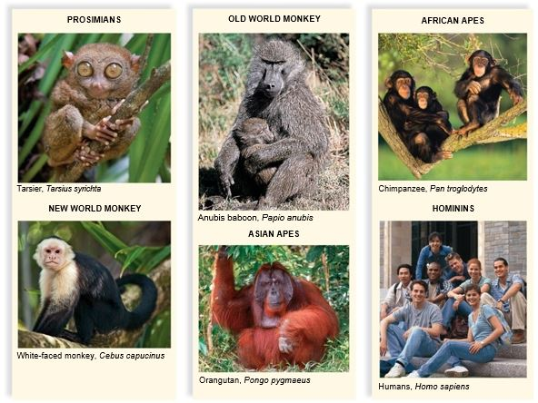
Primate Diversity
Figure 30.1
(tarsier): Magdalena Biskup Travel Photography/Getty Images; (monkey): Paul Souders/Corbis Documentary/Getty Images;
(baboon): St. Meyers/Okapia/Science Source; (orangutan): Tim Davis/Science Source; (chimpanzee): Fuse/Getty Images; (humans): Comstock Images/Getty Images

Slide 5
Mobile Forelimbs and Hindlimbs
Primates tend to have prehensile hands and feet
  Adapted for grasping and holding
  Most primates have flat nails instead of claws
    Sensitive pads on the undersides of fingers and toes
  Many primates also have an opposable thumb
    Thumb can touch each of the other fingers
  Grip is both powerful and precise
  Except for humans, primates with opposable thumbs also have opposable toes
  Mobile limbs and clawless opposable digits allow primates to freely grasp and release tree limbs
    Allow primates to reach out and bring food to the mouth

Slide 6
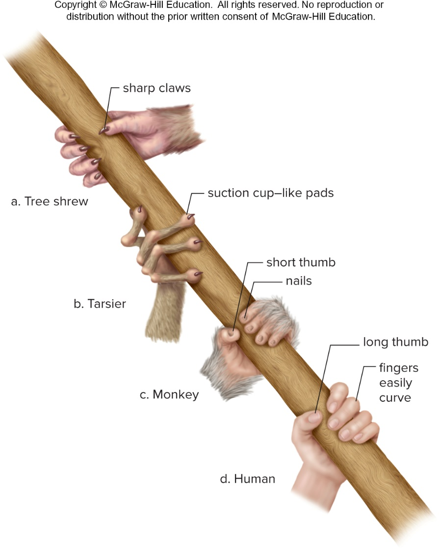
Evolution of Primate Hand
Figure 30.2
Access the text alternative for slide images.

Slide 7
Vision
Stereoscopic vision is a form of vision that combines three-dimensional imaging with good depth perception
  Allows primates to make accurate judgments about distance and position of adjoining tree limbs
Some primates have color vision and greater visual acuity because the retina contains cone cells in addition to rod cells
  Rod cells are activated in dim light
    Image is blurry and in gray tones
  Cone cells require bright light
    Image is sharp and in color
    Humans and the apes have three different kinds of cone cells that can discriminate among greens, blues, and reds

Slide 8
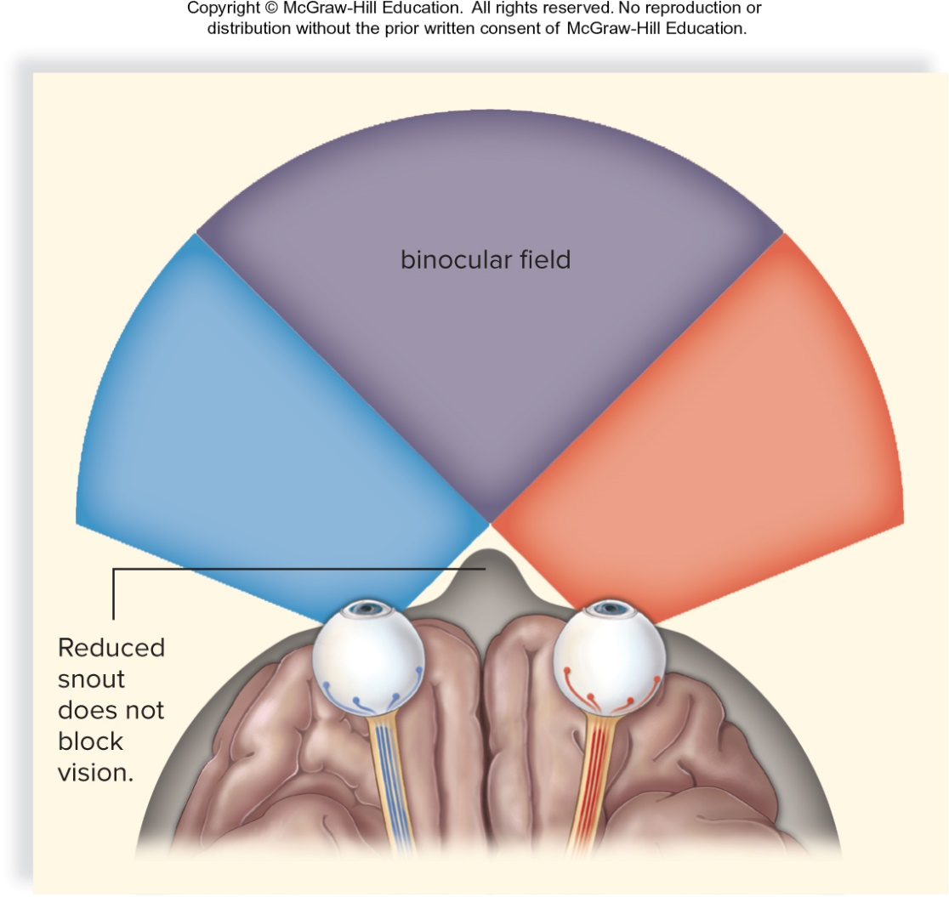
Stereoscopic Vision
Figure 30.3

Slide 9
Large, Complex Brain
Evolutionary trend among primates is toward a larger and more complex brain
  In apes and humans the portion of the brain devoted to smell is smaller
  Portions devoted to sight have increased in size and complexity
  More of the brain is devoted to controlling and processing information received from the hands and the thumbs
      Results in good hand-eye coordination
  Larger portion of the brain is devoted to communication skills
      Supports primates’ tendency to live in social groups

Slide 10
Reduced Reproductive Rates
Trend in primate evolution is a general reduction in the rate of reproduction
  Associated with increased age of sexual maturity and extended life spans
  Gestation is lengthy, allowing time for forebrain development
  Primates generally give birth to one offspring at a time
    Juvenile period of dependency is extended
    Emphasis on learned behavior and complex social interactions

Slide 11
Sequence of Primate Evolution
Hominins includes humans and species very closely related to humans
  Our closest relatives are the chimpanzees
  Gorillas and orangutans are also hominins
  Molecular evidence suggests that humans and chimpanzees shared a common ancestor between 5 and 7 MYA
    Statement that humans descended from chimpanzees (or monkeys and apes) is not accurate

Slide 12
Anthropoids
Anthropoids include hominids, gibbons, Old World monkeys, and New World monkeys
  Old World monkeys, native to Africa and Asia, lack prehensile tails and have protruding noses
    Baboons and the rhesus have been used extensively in medical research
  New World monkeys often have long, prehensile tails and flat noses
    Evolved in South America and are now also found in Central America and parts of Mexico
    Two well-known New World monkeys are the spider monkey and the capuchin
      Capuchins are known as the “organ grinder’s monkey”

Slide 13
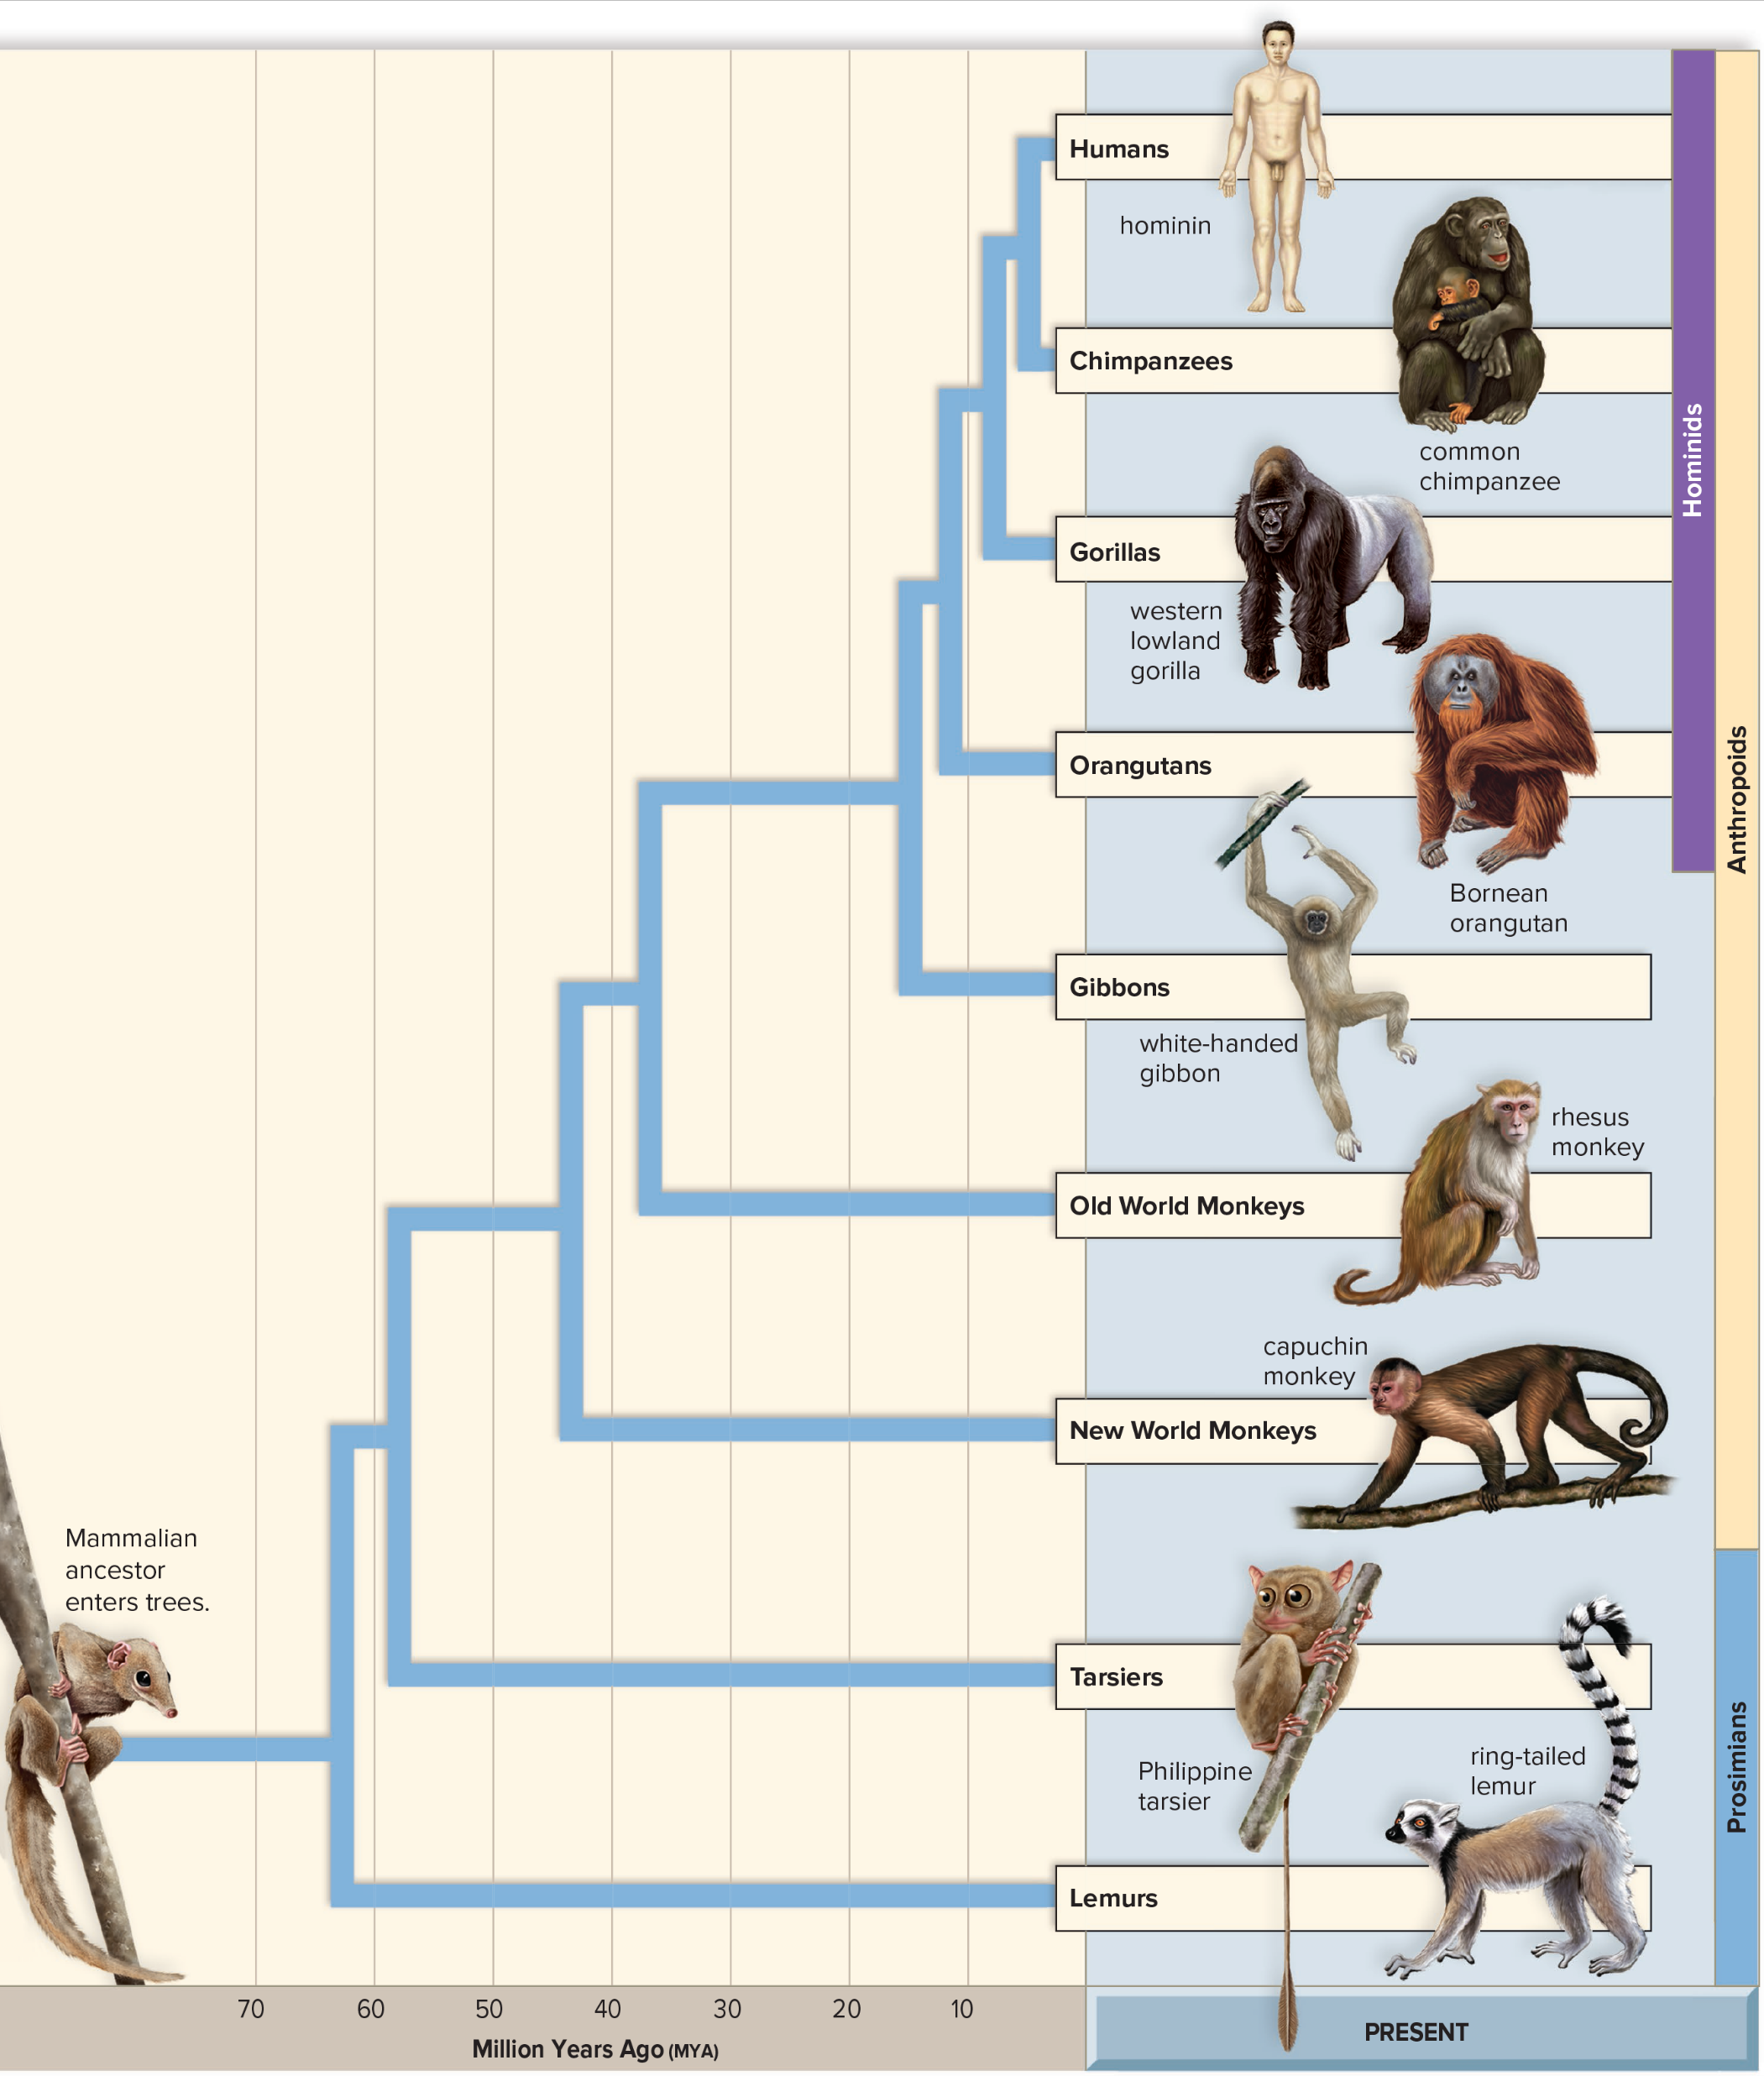
Evolution of Primates
Figure 30.4
Access the text alternative for slide images.

Slide 14
Transitional Links
Primate fossils (45 MYA) similar to monkeys were found in Africa
Hypothesized that ancestors of New World monkeys arrived in South America around 40 MYA
  Uncertain how they arrived because Atlantic crossing was expansive
Transitional link between the monkeys, gibbons, and early hominids (around 35 MYA) is best represented by a fossil classified as Proconsul
  Proconsul was about the size of a baboon, and the size of its brain (165 cc) was also comparable
  Did not have the tail of a monkey
  Limb proportions suggest that it walked as a quadruped on top of tree limbs like monkeys
  Although primarily a tree dweller, Proconsul may have also spent time exploring nearby environments for food

Slide 15
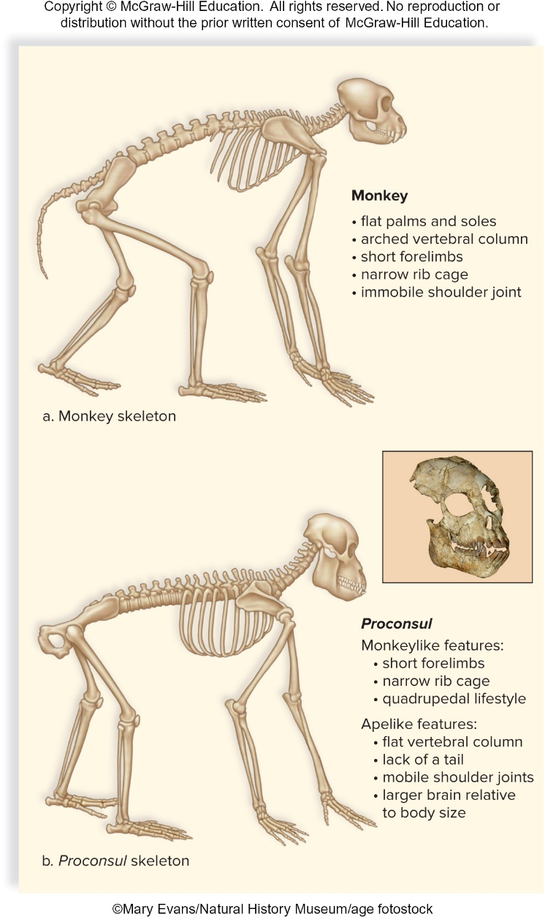
Monkey Skeleton Compared to Proconsul Skeleton
Figure 30.5
Access the text alternative for slide images.
(b): Mary Evans/Natural History Museum/age fotostock

Slide 16
Proconsul
Proconsul was probably ancestral to the dryopithecines, from which the early hominids arose
About 10 mya, Africa Arabia joined with Asia
  Allowed the apes to migrate into Europe and Asia
  In 1966, Spanish paleontologists announced the discovery of a specimen of Dryopithecus dated at 9.5 MYA near Barcelona
  Anatomy of these bones clearly indicates that Dryopithecus was a tree dweller
  Moved by swinging from branch to branch, like gibbons do today
  Did not walk along the top of tree limbs as Proconsul did

Slide 17
Prosimians
Prosimians were the first type of primate to diverge from the common ancestor for all the primates
  Lemurs and tarsiers
All primates share a common mammalian ancestor, which lived about 55 MYA
  This ancestor may have resembled today’s tree shrews

Slide 18
A Genomic Comparison of Homo sapiens and Chimpanzees
The species chimpanzee and humans differ in the numbers of chromosomes they have, yet genetic evidence suggests they are closely related.
  Great apes and humans used to be classified into different families.
    Yale University researchers showed that human chromosome 2 is a fusion of 2 chimpanzee chromosomes.
  Humans and chimpanzees also have similar patterns of transposons and pseudogenes.
  Modern genomic data has shown that the base sequence of chimpanzee and human differ by only 1.5%.
  Noncoding regions that were retained by a particular primate may account for anatomical differences between them.

Slide 19
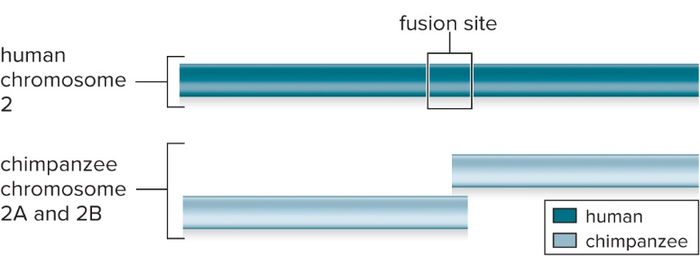
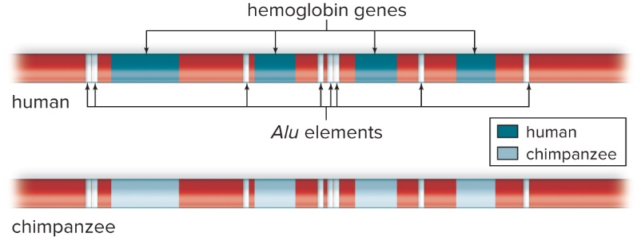
A Comparison of Human and Chimpanzee Chromosomes
Human chromosome 2 is a fusion of two chimpanzee chromosomes.
A comparison of transposon patterns. Similarities in transposon patterns, in this case Alu, suggest a close common ancestor between humans and chimpanzees.
Figure 30A, B
Access the text alternative for slide images.

Slide 20
30.2 Evolution of Humanlike Hominins
Paleontologists use certain anatomical features to determine if a fossil is a hominin. These features include:
  Bipedalism, or the ability to stand erect and walk on two feet
    Humans are bipedal, while apes are quadrupedal (walk on all fours)
    Early humanlike hominins are not in the genus Homo, but are considered closely related to humans, because they exhibit bipedalism
    Upright posture frees the hands for tool use
  Characteristics of the skull: shape of the face and brain size
    Modern humans (flatter face, more pronounced chin) than apes
      Human jaw is shorter than that of the apes
      Human teeth are generally smaller and less specialized
      Chimpanzee brain size (400 cc) compared to modern humans (1,360 cc)

Slide 21
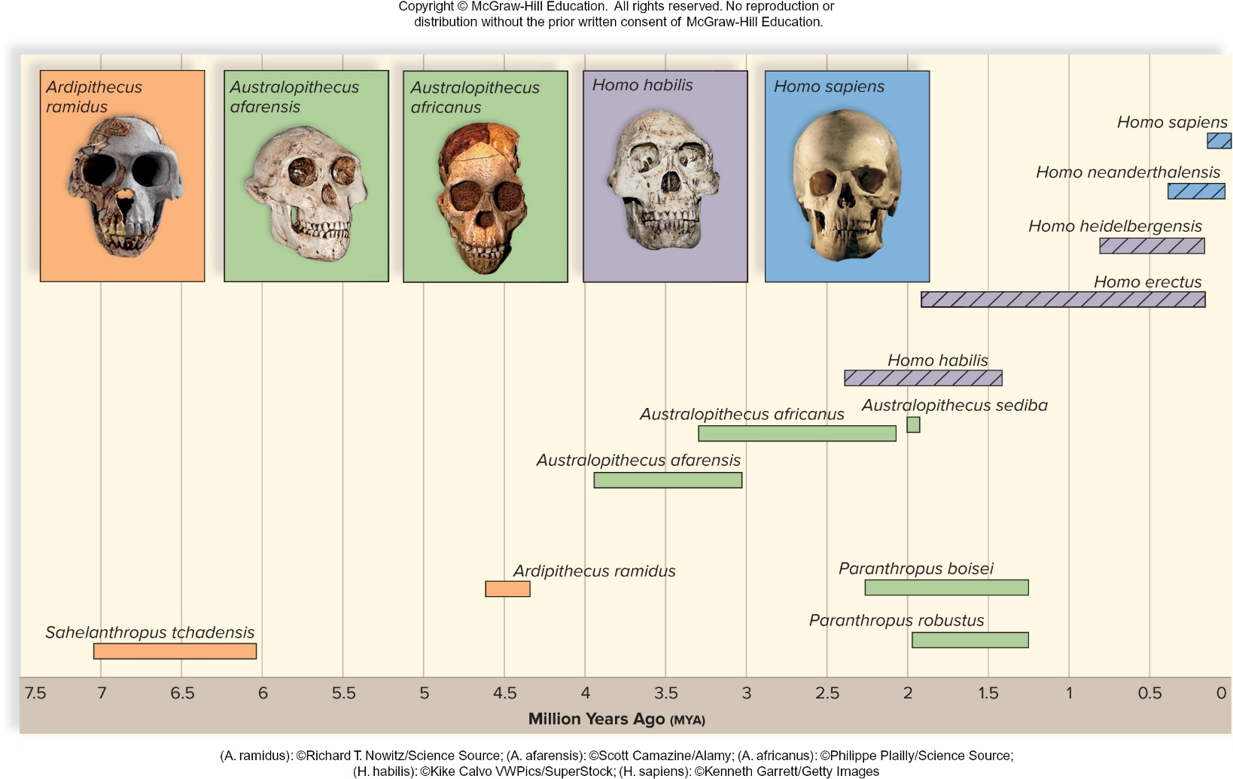
Human Evolution
Figure 30.6
Access the text alternative for slide images.
(photos): (A. ramidus): Richard T. Nowitz/Science Source; (A. afarensis): Scott Camazine/Alamy Stock Photo; (A. africanus): Philippe Plailly/Science Source; (H. habilis): Kike Calvo/Visual & Written/Superstock; (H. sapiens): Kenneth Garrett/Getty Images

Slide 22
Ardipithecus
Two species of Ardipithecus have been uncovered:
  Ardipithecus kadabba
    Only teeth and a few bone bits have been found
    Fossils date between 5.2 and 5.8 MYA
  A. ramidus
    Over 100 skeletons found
    Date to 4.4 MYA
    All fossils are from Ethiopia, East Africa
    In 2009, scientists announced they had reconstructed these fossils to form a female fossil called Ardi

Slide 23
Ardi
Ardi could walk erect, but she spent a lot of time in trees
  Spine exits from the center of the skull rather than toward the rear
  Femurs angle inward toward the knees
    These features assist in walking erect by placing the trunk’s center of gravity squarely over the feet
    Her pelvis and hip joints are broad enough to keep her from swaying from side to side
    Knee joint is modified to support the body’s weight
Ardi’s feet have a bone, absent in apes, that would keep her feet squarely on the ground
  Evidence that she was bipedal
  Like the apes, she has an opposable big toe
Ardi’s wrists were flexible
  Most likely she moved carefully along tree limbs on all fours

Slide 24
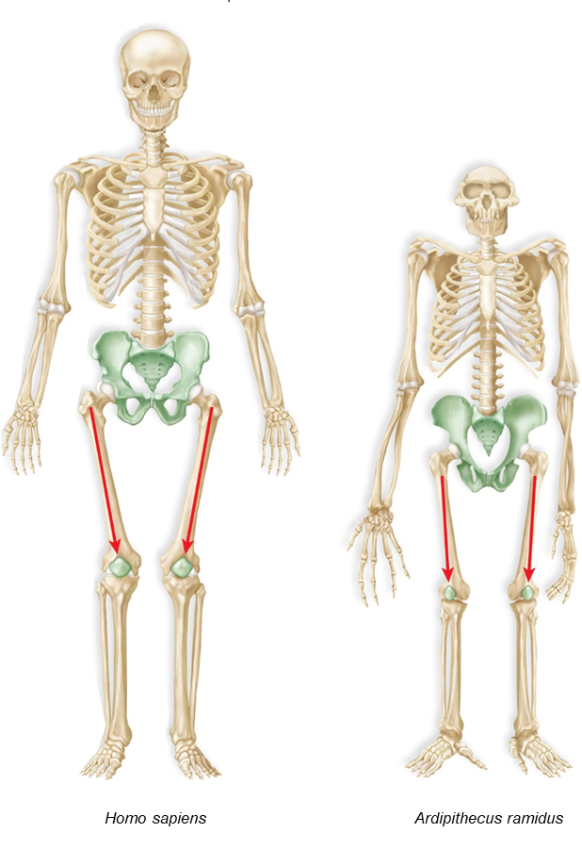
Adaptations for Walking Erect
Figure 30.7
Access the text alternative for slide images.

Slide 25
Ardi’s Features
Some of Ardi’s features are like that of an ape but others are more human
  She was about the size of a chimpanzee
    120 cm (4 ft) tall and weighing about 55 kg (110 lb)
    Males and females were about the same size
  Features of her head include:
    Small compared to the size of her body
    Brain size was around 300 to 350 cc
    Nose and mouth project forward
    Low forehead with heavy eyebrow ridges
    Small teeth
    No sharp canines
      Diet most likely consisted of soft plant material

Slide 26
Ardi’s Environment
Until recently, it has been suggested that bipedalism evolved when a change in climate caused the forests of East Africa to be replaced by grassland
  New evidence suggests that Ardi lived in the woods
    Why would bipedalism be advantageous in a forest?
      Bipedalism provides an advantage in caring for an infant
        Free hands allow the infant to be carried by hand from one location to another
      Bipedalism may have benefited the males of the species
        Useful when foraging for food on the forest floor
  Ardipithecines represent a link between our quadruped ancestors and the bipedal hominins

Slide 27
Australopithecines
  Evolved and diversified in Africa from 4 MYA until 1.5 MYA
  Small brain (apelike), walked erect (humanlike characteristic)
  Evidence of mosaic evolution
    Different body parts evolved at different rates and different times
  110 to 115 centimeters in height
  Small brains were slightly larger than a chimpanzee (370–515 cc)
  Males larger than females
  Some were slight of frame and termed gracile (slender)
  Robust (powerful) with massive jaws and large grinding teeth
    Gracile types are classified in genus Australopithecus
    Robust types into genus Paranthropus
  Consumed some meat
    Used stone tools to scrape meat from bones

Slide 28
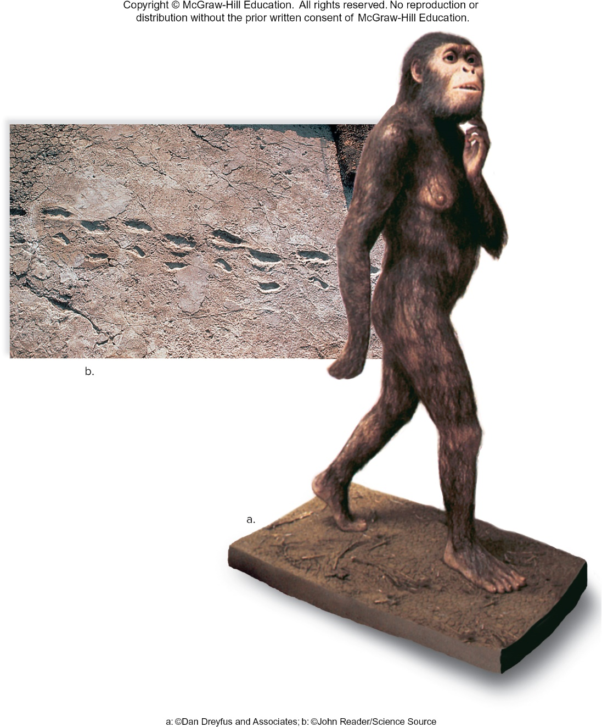
Australopithecus afarensis
Figure 30.8
(a): ©Dan Dreyfus and Associates; (b): John Reader/Science Source

Slide 29
Australopiths
  Eastern Africa
    Australopithecus afarensis
    Lucy
      Bipedal, humanlike, low forehead, large canine teeth, small brain, arms longer than legs
    A. afarensis is considered more directly related to early members of genus Homo than South African species
  Southern Africa
    A. africanus, A. robustus, A. sediba
      Small brain, long arms, climbed trees
      Humanlike pelvis, nose, and dentition
  A. sediba may have been a direct ancestor of the genus Homo

Slide 30
30.3 Evolution of Early Genus Homo
Early Homo species appear in the fossil record approximately 2.5 MYA
Early Homo species all have the following characteristics:
  Brain size that is 600 cc or greater
  Jaws and teeth resemble those of modern humans
  Tool use is evident

Slide 31
Homo habilis and Homo rudolfensis
    Recent evidence suggests they may be a single species, but more fossil evidence is needed to support this idea
    Habilis “handyman” and rudolfensis may have been the first hominins to use stone tools
    Socially organized
    Scavengers
    Cheek teeth are small
      Evidence they were omnivorous
      Consumed both meat and plant material

Slide 32
Homo ergaster and Homo erectus
Many consider them as a single species of H. erectus
First appeared in Africa around 1.9 MYA
H. erectus evolved either directly from H. habilis or from an earlier common ancestor
Compared to earlier Homo species, H. erectus had:
  Larger brain
  Rounder jaw
  Prominent brow ridges
  Projecting nose
    Adaptive for a hot, dry climate
      Permits water to be removed before air leaves the body

Slide 33
H. ergaster and erectus
H. erectus was much taller than earlier hominins
  Males were 1.8 m tall
  Females were 1.55 m tall
Gait similar to modern humans
Size of birth canal indicates infants were born prematurely
  Babies required an extended period of care
H. erectus was first species to migrate into Europe and Asia
  Migrations occurred between 2.5 MYA and 1 MYA
    Extensive migration is a first in the history of humankind
Knowledge of fire; may have been the first to cook meat

Slide 34
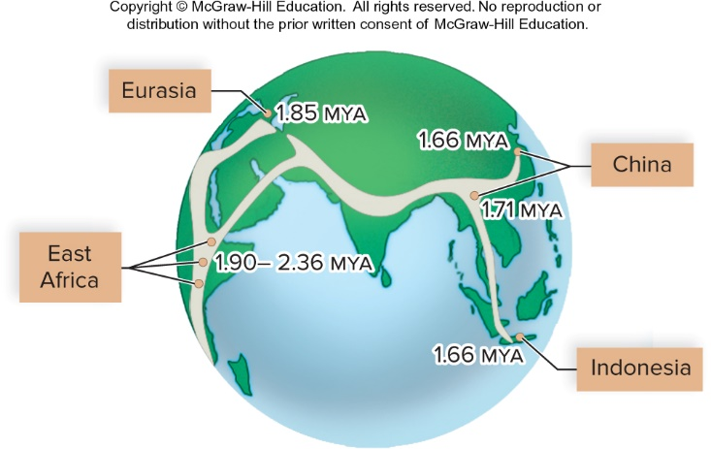
Migration out of Africa
Figure 30.10

Slide 35
Timeline for End of Homo erectus
There is considerable debate as to when Homo erectus died out
  Most estimates suggest several hundred thousand years ago
  Newer evidence suggests that they died out 100,000 years ago
    May be possible that H. erectus interacted with other Homo species much later than earlier predicted

Slide 36
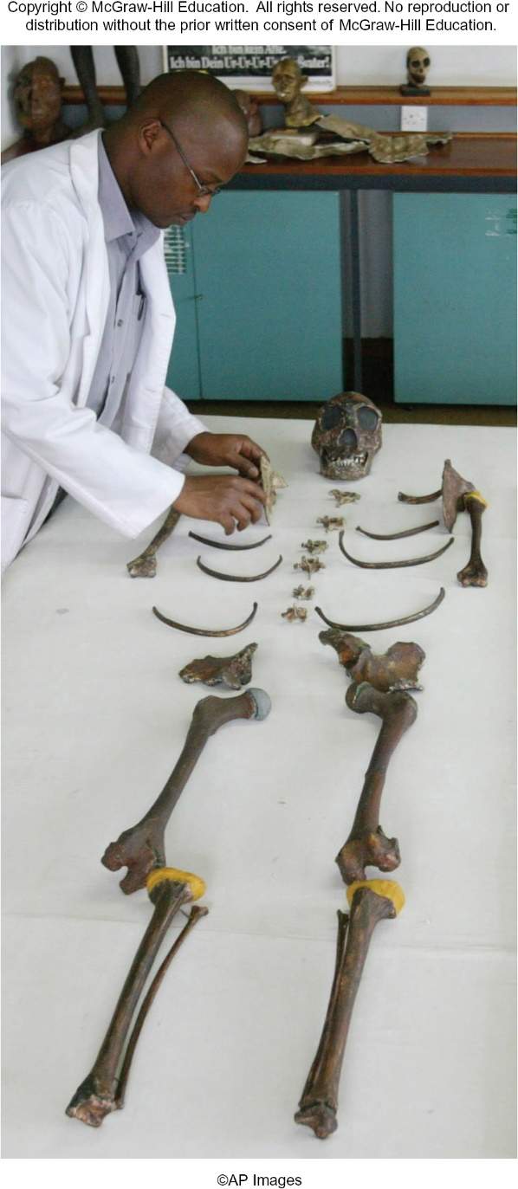
Homo erectus
Figure 30.9
SAYYID AZIM/AP Images

Slide 37
30.4 Evolution of Later Genus Homo
Most researchers believe Homo sapiens evolved from an H. erectus lineage in Africa
  Much disagreement exists over when they evolved
  Recent discoveries of fossil remains is challenging much of what we know about this period in human evolution

Slide 38
Homo heidelbergensis and the Transition to Modern Humans
  Populations of H. erectus persisted until about 100,000 years ago in Asia
    Several lineages diverged
      Homo floresiensis, a dwarf island species
      Homo heidelbergensis
        Replaced H. erectus in Africa 500,000 years ago
        Most likely lineage that led to modern humans
          Had a larger brain size
          More advanced tool use and social behavior
          Appear to be the first species to build shelters

Slide 39
Transition to Modern Humans
A clear dividing line has not been found between fossils from late H. erectus and H. heidelbergensis
  Fossils start appearing 700,000 years ago in Africa
Most supported scenario is that modern humans evolved from H. heidelbergensis in three lineages between 700,000 and 200,000 years ago
  Modern H. sapiens evolved from lineage in Africa
  Asian lineage evolved in “Denisovans”
  European lineage evolved into H. neanderthalensis
  Some modern humans have DNA from all three lineages

Slide 40
Evolutionary Hypotheses
Primary hypothesis for the evolution of modern humans from earlier Homo species is called the replacement model or out-of-Africa hypothesis
  Proposes that modern humans evolved from archaic humans only in Africa
  Modern humans then migrated to Asia and Europe
    Replaced the early Homo species about 100,000 years BP
  Replacement model has historically been supported by the fossil record
    Earliest remains of modern humans found only in Africa
    Modern humans are not found in Asia until 100,000 years BP and not in Europe until 60,000 years BP

Slide 41
The Replacement Model
Replacement model is also supported by DNA data
  A study showed that the mitochondrial DNA of Africans is more diverse than the DNA of the people in Europe and the rest of the world
  This is significant if mitochondrial DNA has a constant rate of mutation
    Africans should show the greatest diversity, because modern humans have existed the longest in Africa

Slide 42
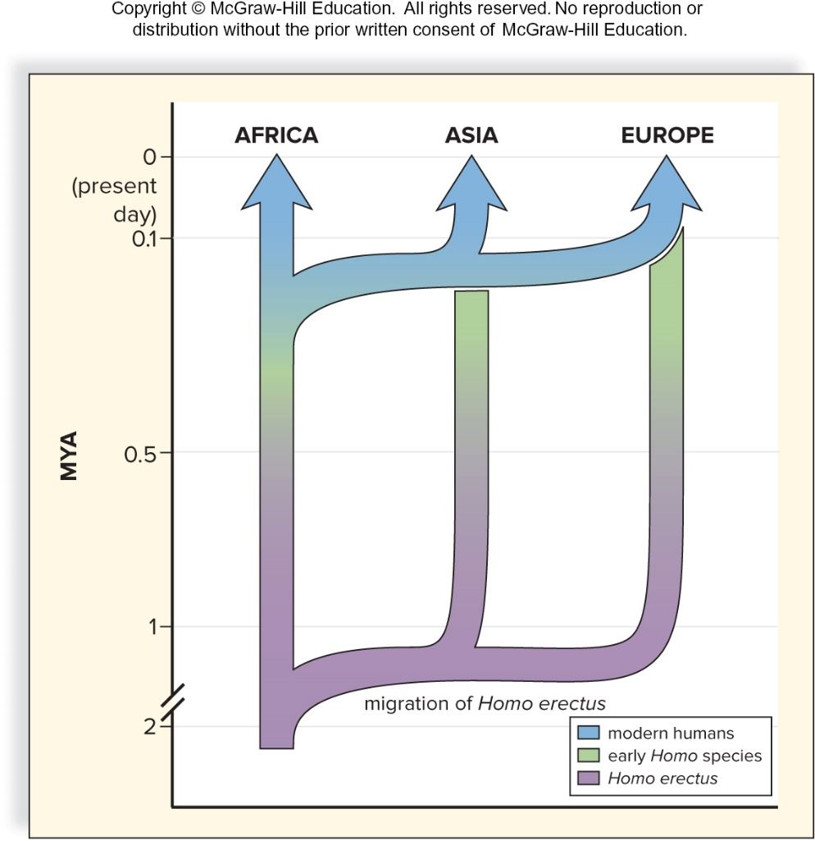
Replacement Model
Figure 30.11
Access the text alternative for slide images.

Slide 43
Multiregional Continuity Hypothesis
Hypothesis opposing the replacement model does exist
  Multiregional continuity hypothesis proposes that modern humans arose from earlier Homo species in essentially the same manner in Africa, Asia, and Europe
    Hypothesis is multiregional, because it applies equally to Africa, Asia, and Europe
    It proposes that in these regions genetic continuity will be found between modern populations and early Homo
    Discovery of new species, such as H. florensiensis, H. naledi, and the Denisovans, is bringing attention back to this hypothesis, or possibly a combination of the multiregional and replacement models

Slide 44
Neanderthals
  Neanderthal (Homo neanderthalensis) originated over 400,000 years ago and survived until 30,000 years ago
    Appear to have evolved from a lineage of H. heidelbergensis migrating out of Africa
  According to the replacement model, the Neanderthals were also supplanted by modern humans

Slide 45
Neanderthals’ Characteristics
    Neanderthal brain was slightly larger than that of Homo sapiens
      1,400 cc, compared with 1,360 cc in most modern humans
    Neanderthals had massive brow ridges and wide, flat noses
    They had a forward-sloping forehead and a receding lower jaw
      Their nose, jaws, and teeth protruded far forward
    Neanderthals were powerful and heavily muscled
    Bones of Neanderthals were shorter and thicker than those of modern humans
    New fossils show that the pubic bone was longer compared to that of modern humans
      Neanderthals lived in Europe and Asia during the last Ice Age, and their sturdy build could have helped conserve heat

Slide 46
Neanderthals’ Timeline
Homo neanderthalensis fossils have been found in Europe and Asia
  Were probably the dominant hominin group for hundreds of thousands of years
  About 80,000 to 100,000 years ago, ancestors of modern humans entered Europe from the south
  Neanderthals disappeared about 30,000 years ago, but what caused their extinction is still a matter of much scientific debate
Many hypotheses as to what may have happened:
  Conflict between Neanderthals and early H. sapiens
  Infectious diseases that traveled with H. sapiens to Europe
  Modern humans may have outcompeted the Neanderthals in hunting and gathering of food, depleting available resources
  Neanderthals may have died out for reasons completely unrelated to H. sapiens

Slide 47
Neanderthals Were Advanced
Archaeological evidence suggests that Neanderthals were culturally advanced
  Some Neanderthals lived in caves, others probably constructed shelters
  Made a variety of stone tools such as spear points, which could have been used for hunting, and scrapers and knives, which would have helped in food preparation
  Most likely hunted bears, woolly mammoths, rhinoceroses, reindeer, and other contemporary animals
  Used and could control probably helped in cooking frozen meat and in keeping warm
  Buried their dead with flowers and tools and may have had a religion

Slide 48
Cro-Magnons
  Oldest fossils to be designated H. sapiens
  Entered Asia and Europe from Africa 100,000 years ago
    Interbred with Neanderthals and Denisovans
    Reached western Europe 40,000 years ago
  Hunter-gatherers
Looked like modern humans
  Lighter bones
  Flat high foreheads
  Domed skulls housing brains of 1,590 cc
  Small teeth
  Distinct chin

Slide 49
Tool Use in Cro-Magnons
  Cro-Magnon designed and manipulated sophisticated tools and weapons
    Compound tools, knifelike blades and spears
      Killed animals from a distance
      Some researchers believe they may have been responsible for the extinction of many larger mammals during the late Pleistocene epoch
        Event is known as the Pleistocene overkill

Slide 50
Language and Cro-Magnons
  More highly developed brain may have allowed them to perfect language composed of patterned sounds
    Enhanced possibilities for cooperation and sense of cohesion
  Artistic achievements included small sculptures, cave paintings, and realistic depictions of animals
    Showed symbolic thinking as would be needed for speech

Slide 51
Rise of Agriculture
  Cro-Magnons combined hunting and fishing with gathering fruits, berries, grains, and wild root crops
  Full dependency on domestic crops and animals didn’t occur until about 4,500 years ago
  It is believed that extinctions of large game animals and climate change may have dictated lifestyle changes, such as the turn to agriculture
    An increase in agriculture enhanced the process of biocultural evolution
        Cultural achievements are influenced by natural selection

Slide 52
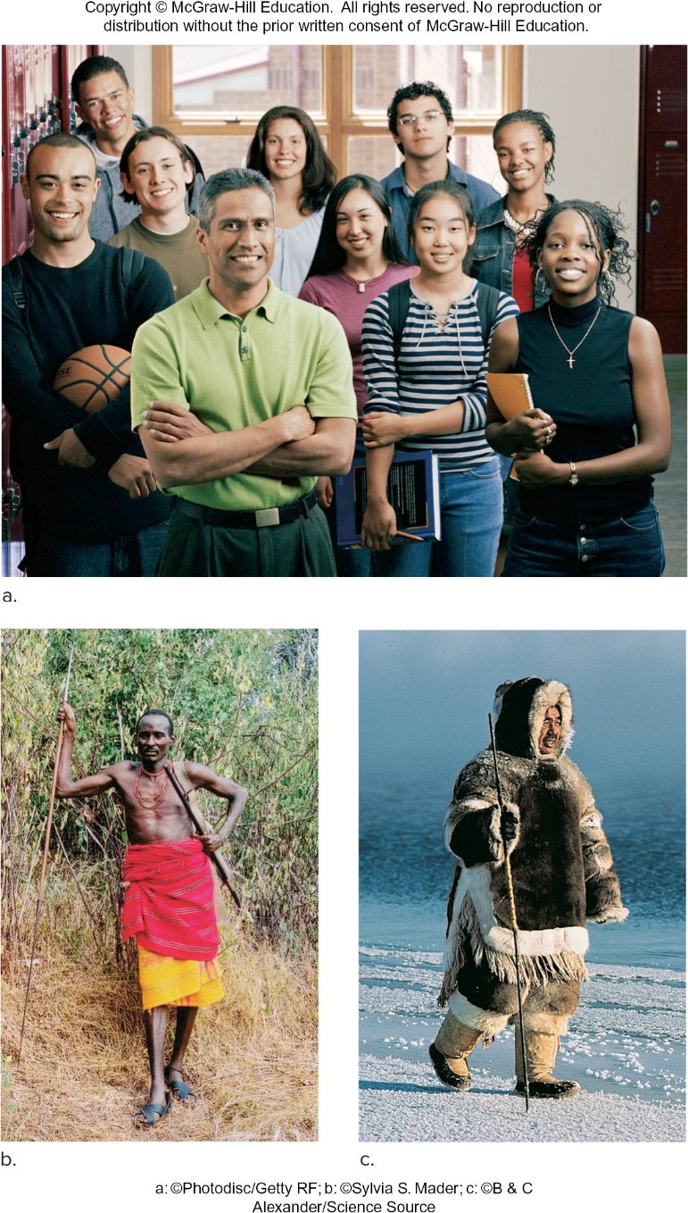
Ethnic Groups
Figure 30.12
(a): Anderson Ross/Getty Images; (b): ©Sylvia S. Mader; (c): Ton Koene/Alamy Stock Photo

Slide 53
Human Variation
Evolutionists hypothesize that some human variations evolved as adaptations to local environmental conditions
    Skin color
      White skin ensures vitamin D production when UV intensity is low
      Dark skin is protective against the high UV of bright sunlight
  Body shape and environmental conditions
    Bergmann’s rule states that in colder regions animals have bulkier bodies
    Allen’s rule states that in colder regions animals have shorter limbs, digits, and ears
      Both effects help regulate body temperature by changes to surface-area-to-volume ratio

Slide 54
Genetic Evidence for a Common Ancestry
Replacement model pertains to the origin of ethnic groups
  Proposes that all modern humans have a relatively recent common ancestor, Cro-Magnon, who evolved in Africa and spread to other regions
  Variation is less among modern populations than among archaic human populations
Comparative study of mitochondrial DNA shows that differences among human populations are consistent with having a common ancestor no more than a million years ago
    Lewontin examined variations in 17 genes among seven major geographic groups and found that the great majority of genetic variation occurs within, not between, ethnic groups

Slide 55
End of main content
Copyright 2022 © McGraw Hill LLC. All rights reserved. No reproduction or distribution without the prior written consent of McGraw Hill LLC.

Slide 56
Accessibility Content: Text Alternatives for Images

Slide 57
Evolution of Primate Hand - Text Alternative
Return to parent-slide containing images.
The details of hands are as follows:
Tree shrew: sharp claws.
Tarsier: suction cup-like pads.
Monkey: short thumb and nails; and
Human: long thumb and easily curved fingers.
Return to parent-slide containing images.

Slide 58
Evolution of Primates - Text Alternative
Return to parent-slide containing images.
The data ranges from 70 (million years ago) to present is as follows:
70 to 60:
Mammalian ancestor branches into lemurs and tarsiers (prosimians) and new world monkeys, old world monkeys, gibbons, orangutans, gorillas, chimpanzees and humans (anthropods).
60 to 50:
Mammalian ancestor branches into tarsiers (prosimians) and new world monkeys, old world monkeys, gibbons, orangutans, gorillas, chimpanzees and humans (anthropods).
50 to 40:
Mammalian ancestor branches into new world monkeys, old world monkeys, gibbons: (anthropods); and orangutans, gorillas, chimpanzees and humans: (hominids).
40 to 20:
Mammalian ancestor branches into old world monkeys, gibbons: (anthropods); and orangutans, gorillas, chimpanzees and humans: (hominids).
20 to 10:
Mammalian ancestor branches into gibbons: (anthropods); and orangutans, gorillas, chimpanzees and humans: (hominids).
10 to present:
Mammalian ancestor branches into gorillas, chimpanzees and humans: (hominids).
Return to parent-slide containing images.

Slide 59
Monkey Skeleton Compared to Proconsul Skeleton - Text Alternative
Return to parent-slide containing images.
The features of monkeys are:
flat palms and soles; arched vertebral column; short forelimbs; narrow rib cage; immobile shoulder joint.
The features of proconsuls are:
Monkeylike features include:
short forelimbs; narrow rib cage; quadrupedal lifestyle.
Apelike features include:
flat vertebral column; lack of a tail; mobile shoulder joints; larger brain relative to body size.
Return to parent-slide containing images.

Slide 60
A Comparison of Human and Chimpanzee Chromosomes - Text Alternative
Return to parent-slide containing images.
Human chromosome 2 is one long segment that aligns with two separate chimpanzee chromosome segments, called 2 A and 2 B. During the evolution of hominins, the 2 A and 2 B chromosome segments fused end to end and gave rise to one, long human chromosome 2 with a proposed fusion site in the middle. Another similarity between human and chimpanzee genomes is the pattern of transposons in their genomes. For example, the ALU element is present in the same eight places among four hemoglobin genes in both humans and chimpanzees. This similarity suggests that the transposon inserted itself into these locations before the chimpanzee-human lineages split.
Return to parent-slide containing images.

Slide 61
Human Evolution - Text Alternative
Return to parent-slide containing images.
The horizontal axis represents millions of years ago ranging from 7.5 to 0.
The data (in millions of years ago) for existence of extinct hominins are as follows:
Sahelanthropus tchadensis: 7.1 to 6.07
Ardipithecus ramidus: 4.65 to 4.35
Paranthropus robustus: 1.9 to 1.25
Paranthropus boisei: 2.25 to 1.25
Australopithecus afarensis: 3.9 to 3.02
Australopithecus africanus: 3.25 to 2.1
Australopithecus sediba: 1.9 to 2.0
Homo habilis: 2.4 to 1.4
Homo erectus: 1.9 to 0.2
Homo heidelbergensis: 0.75 to 0.2
Homo neanderthalensis: 0.15 to 0.35
Homo sapiens: 0 to 2.
Note: All data is approximate.
Return to parent-slide containing images.

Slide 62
Adaptations for Walking Erect - Text Alternative
Return to parent-slide containing images.
In both, the spine exits from the center of the skull, the pelvis is wide and bowl-shaped, and the knee joints are broad. All of these features place the trunk's center of gravity squarely over the feet. The Ardipithecus skeleton differs from that of Homo sapiens in that it is about 1.5 feet shorter, the femur bones don't angle in as much as they do in Homo sapiens, the collarbones angle up slightly, the forelimbs are longer and the hands are larger than those of Homo sapiens, the skull is smaller with a smaller braincase, and the big toe is splayed out to the side.
Return to parent-slide containing images.

Slide 63
Replacement Model - Text Alternative
Return to parent-slide containing images.
The horizontal axis represents routes to Africa, Asia and Europe, while the vertical axis represents million years ago ranging from 2 to 0 (present day).
The data (in millions of years ago) is as follows:
Migration of Homo erectus:
Africa: 2.3 to 0.5
Asia: 2.3 to 0.4
Europe: 2.3 to 0.3
Migration of early Homo species:
Africa: 0.5 to 0.25
Asia: 0.4 to 0.17
Europe: 0.3 to 0.09
Migration of modern humans:
Africa: 0.25 to 0
Asia: 0.17 to 0
Europe: 0.09 to 0
Note: All data is approximate.
Return to parent-slide containing images.

